Slide 1
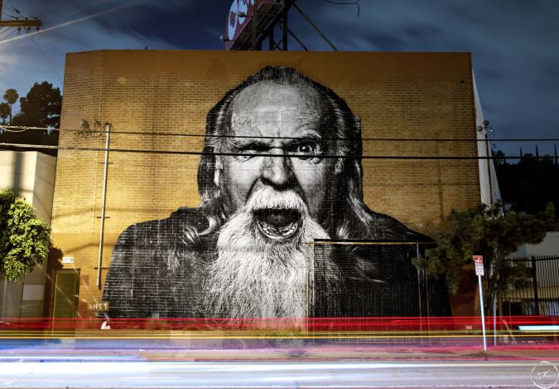

Culture as a driver for an Age-Friendly city-region
Paul McGarry,
Greater Manchester Combined Authority

Slide 2
"Population ageing and urbanisation have in their different ways become the key social trends of the twenty-first century."
Prof Chris Phillipson 2010

Slide 3
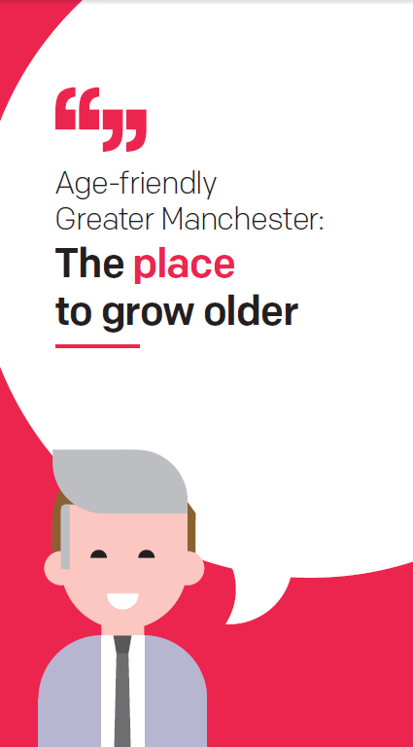
Greater Manchester Ageing Hub
Greater Manchester Ageing Hub in 2016 to coordinate a strategic response to the opportunities and challenges of an ageing population
Ageing is one of ten Mayoral priorities, Greater Manchester Strategy
2018: UK’s first age-friendly city region, World Health Organization
Strategic Partnership with the Centre for Ageing Better since 2016
Founding member of UK network of age friendly communities
Focus on reducing inequalities across all of the objectives
Notes:
Great to be here. It’s always a helpful opportunity preparing these presentations to reflect on what we’ve been doing and what our plans are. Certainly I think in the current circumstances these opportunities to reflect and learn with others are really welcome.
And I am personally someone who has been really appreciative of the role physical activity plays in my physical and mental wellbeing during this time. And that includes discovering new things – the short “about town” walks with friends with no purpose other than to chat and the wonders of my local park where I have even picked up a tennis racket. I also see some of the things that can get in the way of being active – and so it feels like a really good opportunity to be reviewing the Active Ageing programme, getting curious and maybe refreshing some of our thinking on getting people moving in Greater Manchester.
My role is to manage the partnership between
Today I’m going to talk a little bit about quite a few things. More than happy to answer any questions that come through in the chat or pick up anything in more detail with people afterwards. I’m going to talk about the work of the Ageing Hub, some of the responses to Covid, recovery planning as it relates to physical activity for over 50s and then talk about the Centre for Ageing Better and our Healthy Ageing goal.
The “Hub” is a partnership of GMCA, HSCP, wide range of other GM agencies and the 10 local authorities in GM. Its supported by a small core team at GMCA, but it really is that partnership and the collaboration that is at the heart of making Greater Manchester the best place to grow older.

Slide 5
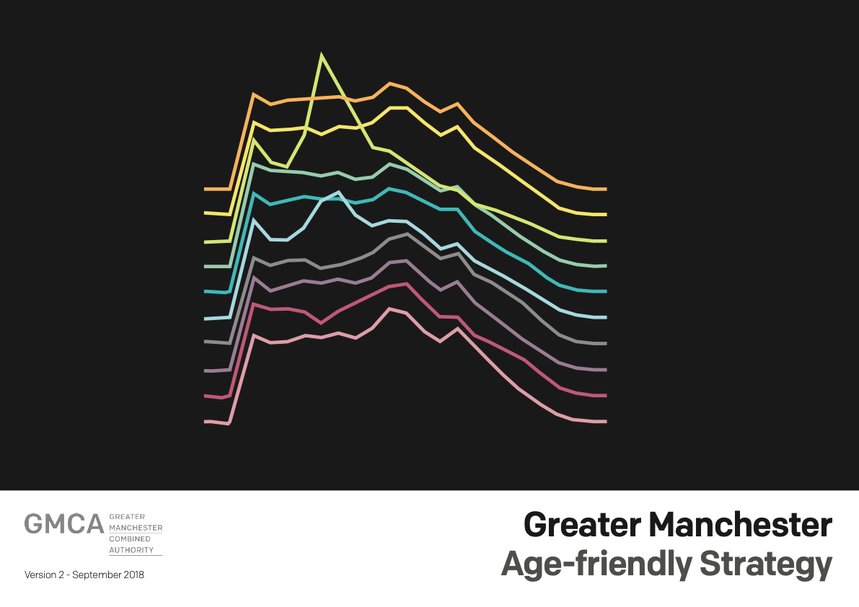

Slide 6

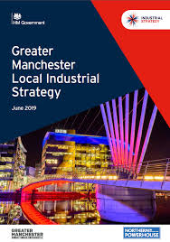
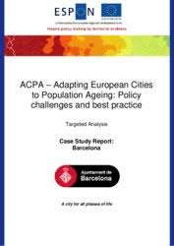
GM Ecosystem for working internationally on ageing
Policy
EU-ESPON / ACPA with eight European countries
Eurocities Urban Ageing Working Group
European Green paper on Ageing
Research
EIP –AHA Four Star Reference site
Innovation and growth
Local Industrial Strategy
Innovation Partnership for Action on Healthy Ageing
International Centre
Notes:
The best way to encapsulate something of the strength of working within the Hub is to look at some of the responses to Covid-19.
I think we see collaboration across sectors, older people’s voice and participation, evidence-based, learning and building a movement of age-friendly leaders across the system.
Stood up fairly quickly a weekly on-line meeting with locality age-friendly leads and other GM agencies to support colleagues, provide information and updates; supplemented by twice-weekly email bulletins.
Quite quickly resulted in some rapid escalation of issues that needed addressing in that first lockdown – so very responsive, reactive e.g. concessionary travel relaxation, from Greater Sport we saw messaging and signposting to resources for staying active in and close to the home online within that first couple of weeks I think.
Then there were some less reactive pieces of work so 67,000 copies Keeping Well at Home printed and distributed as well as digital publication – presented a range of messages on physical functioning, mental wellbeing and social connection. Has been evaluated, is now a WHO case study and work is busily underway on a further publication and campaign Keep Well this Winter.
16,000 Creative Care Kits created and delivered by colleagues from GMCA culture team to older people across GM
Responding to concerns from older people – GM Older People’s Network about the representation of older people as “vulnerable” and “shielded” with the #ValuableNotVulnerable campaign
Key pieces of research and analysis e.g. Ipsos MORI polling from Ageing Better; MUARG research on experiences of socially excluded older people; Ambition for Ageing rapid reviews (ICT and social connection, cash);
GMCVO guidance "Developing social contact models in a time of social distancing“
At same time continued much of the planned work – notably and importantly on employment support for over 50s, where GMCA with Ageing Better and DWP is developing a pilot on new ways to deliver.
Included in June the Mayor joining the Centre for Ageing Better webinar, The Road to Recovery: how can the Covid-19 crisis provide opportunities to improve later lives?

Slide 7
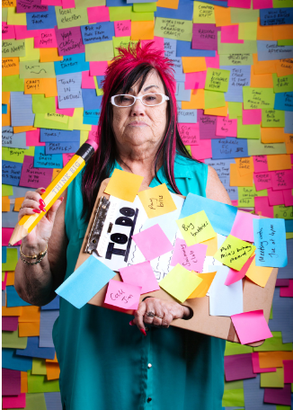
Culture, ageing and place-based working
Programme launched in 2009 in City of Manchester, in Greater Manchester in 2016.
Cultural strategy and funding almost exclusively focused on children and young people – the challenge to Manchester institutions
Partnership with Baring Foundation
Built city-wide capacity / expertise and infrastructure
Enable and promote later life creativity and talent
Changing the narrative and tackling ageism
Promote a shared commitment and activities to reach those who are least likely to participate
Still a challenge to shift thinking on ageing………

Slide 8
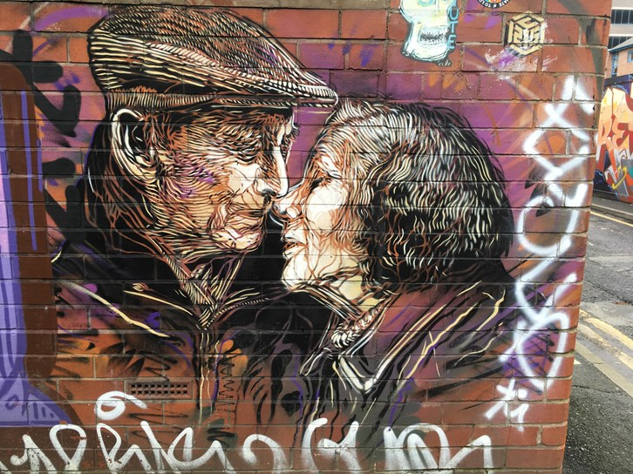
Age-friendly culture in Greater Manchester
Culture Champions: in six GM local authorities: Large-scale volunteer ambassador scheme aimed to develop age-friendly volunteering and engagement in cultural activities.
Back in the Closet: Working with housing providers to address lack of LGBTQ visibility and homophobia in extra care schemes. 5 artists in 5 schemes. Still managed to deliver during the pandemic.
bOlder programme: Innovative and unique in focussing on older talent development not just passive recipients of culture, older artists as economically active

Slide 9
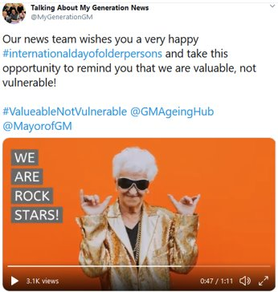
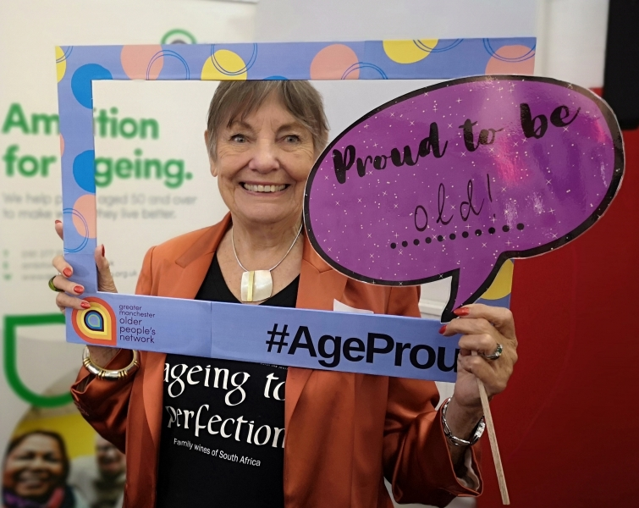
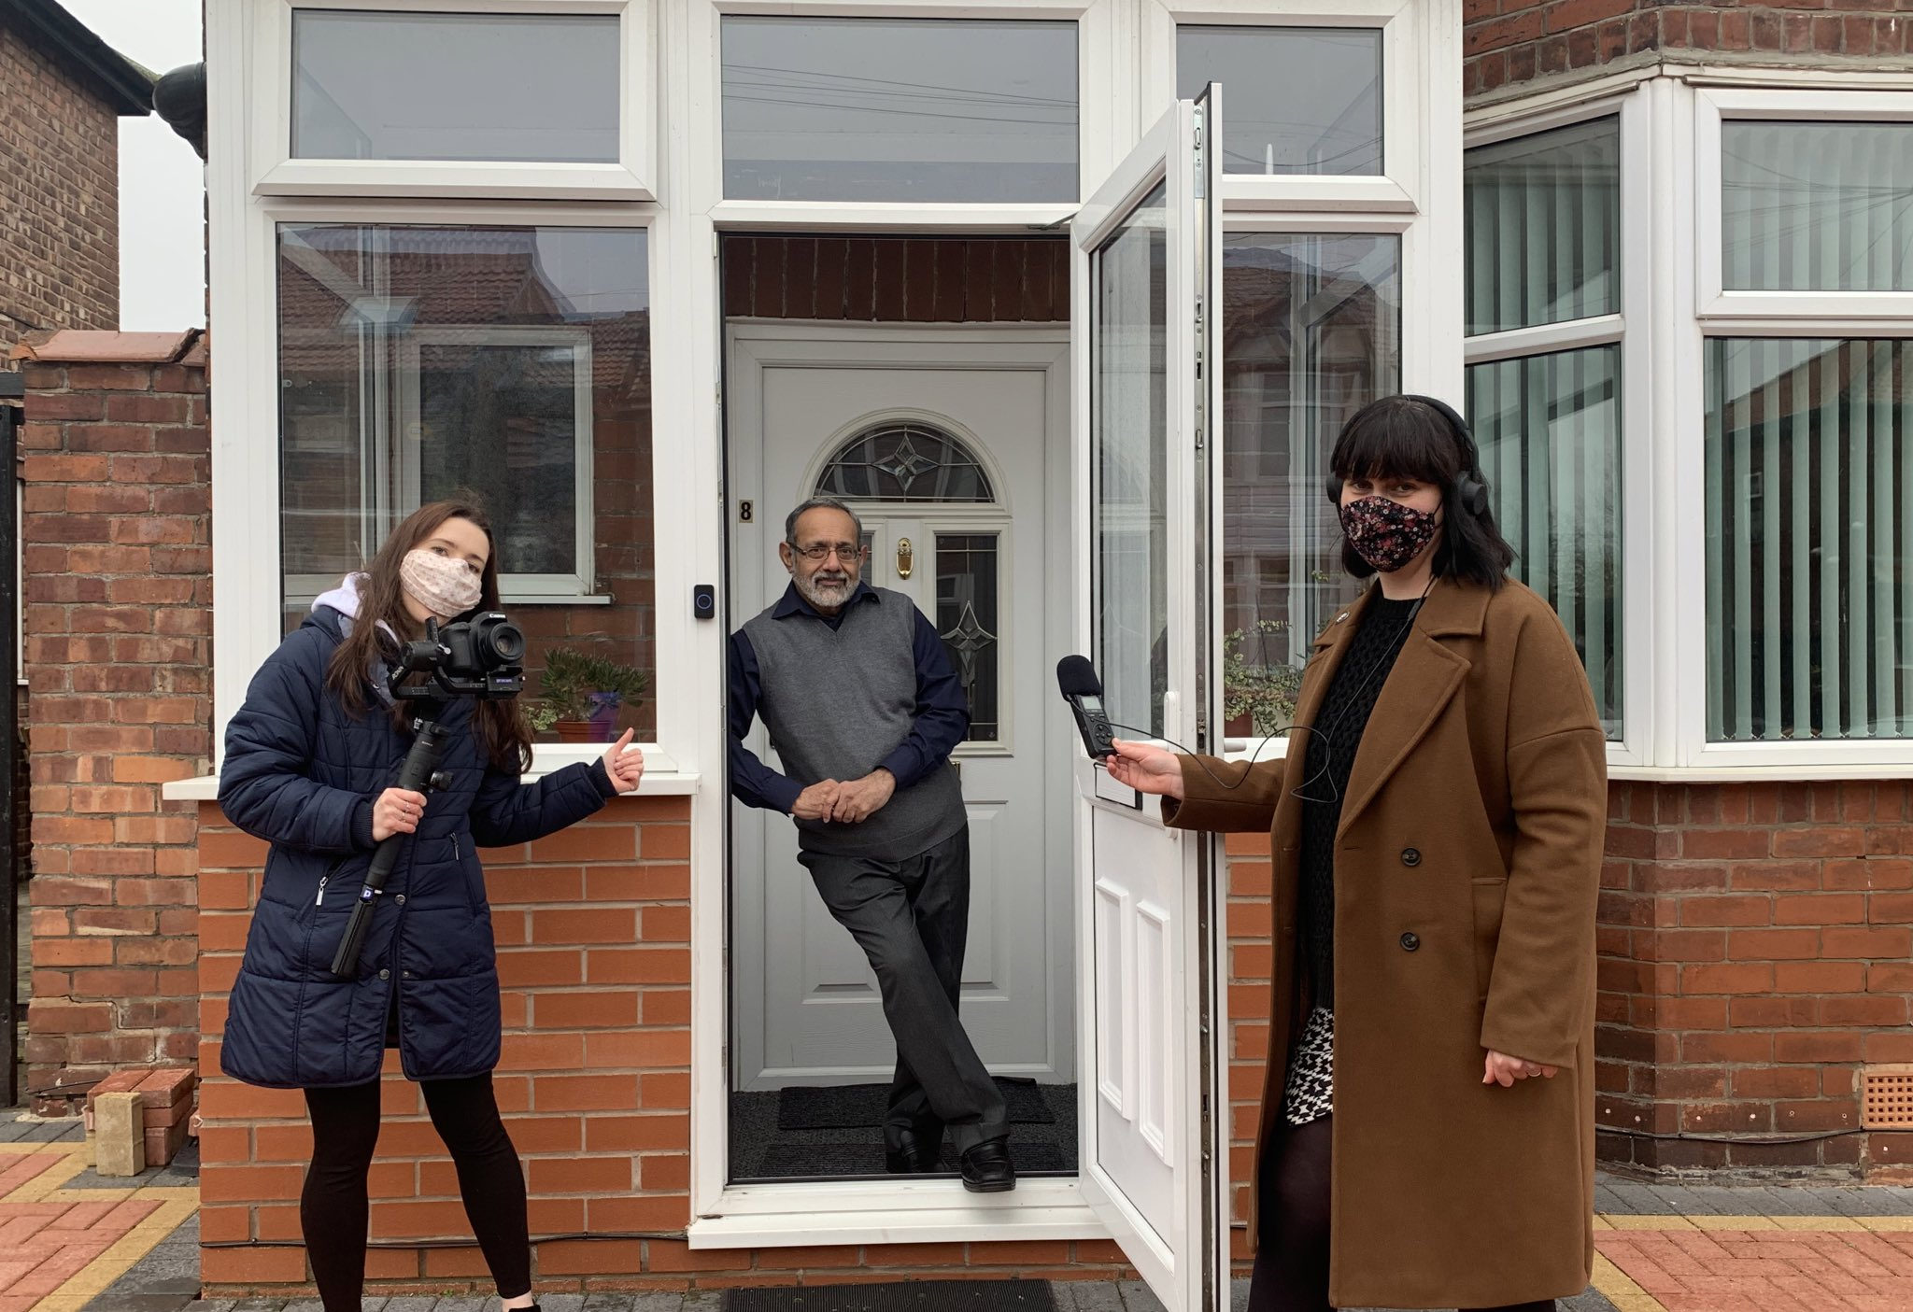
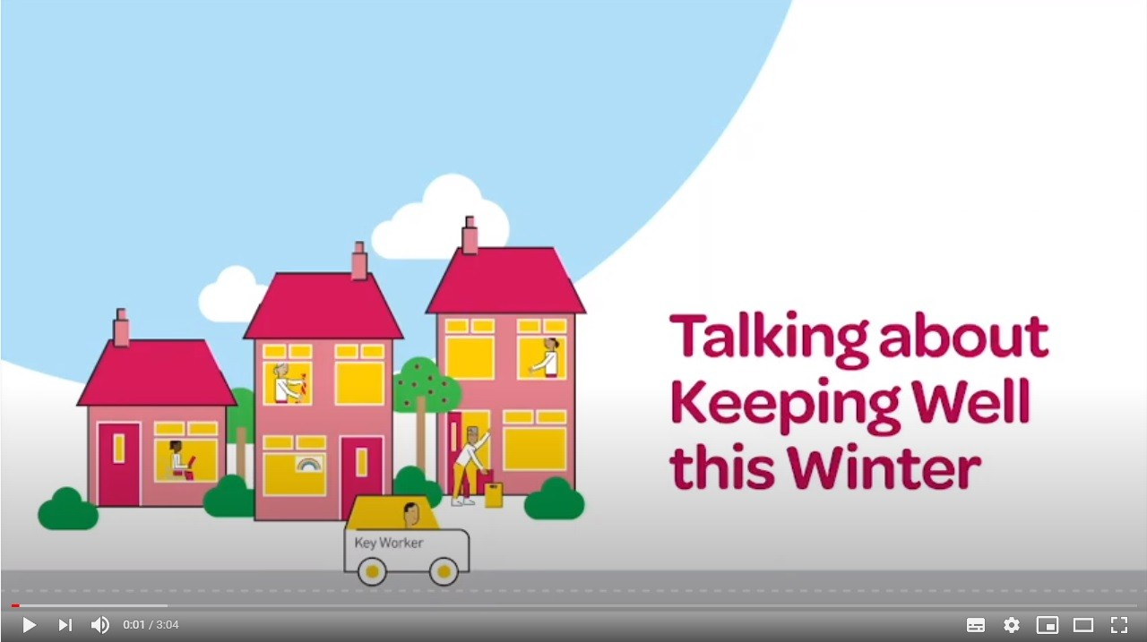
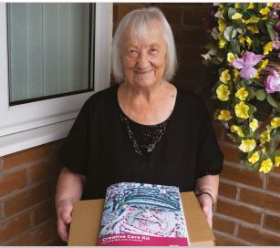
Responding to Covid-19
Worked with organisations from across city region for ‘Valuable, not vulnerable” campaign
“Old frame, New picture” photography competition promoting positive and realistic images of later life
Collaborated with Talking about My Generation to disseminate key messages
Keeping Well this Winter: older people reporting, sharing, developing cultural/creative content
Disseminated GM creative kits to 16,000 older people across city region
Looking forward to Summer

Slide 10

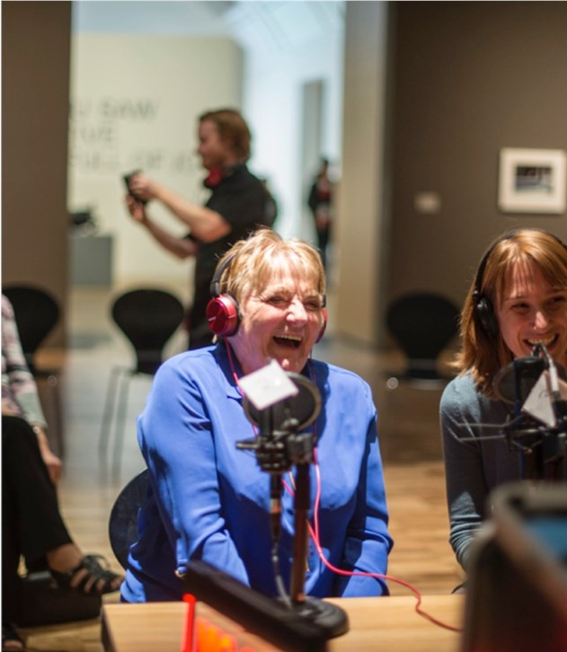
‘Infinity and beyond’ in Greater Manchester
CADA is new national sector support agency for age-friendly culture. They exist to:
  challenge ageism in the arts and heritage sectors and in society more widely
  lead a fundamental rethink and reflection on ageing and creativity
  harness collective energy and impact to support systemic change
Ageing and culture is part of the longevity dividend or silver economy
“We are working to integrate all these sectors in one approach so we work with older people who want to make, to produce, to earn money, to take part, to meet others, improve their health and simply have fun.”

Slide 11
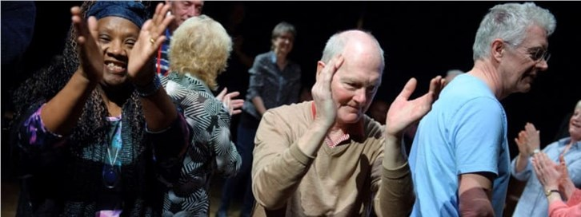

Greater Manchester Ageing Hub
Twitter: @GMAgeingHub
Email: ageinghub@greatermanchester-ca.gov.uk
Visit: www.greatermanchester-ca.gov.uk/what-we-do/ageing/

