Slide 1
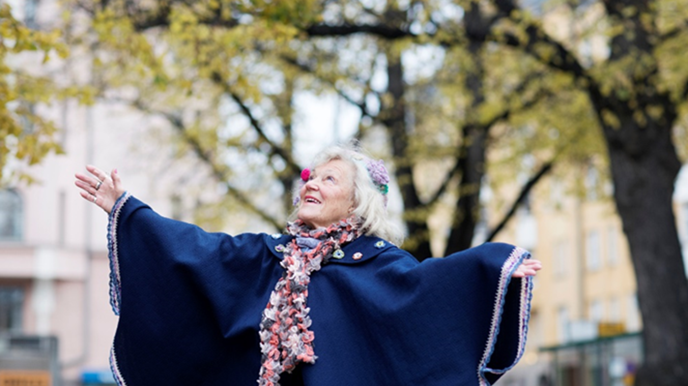
Developing cultural services for the Elderly
City of Helsinki
Mari Männistö
Culture Director
Culture and Leisure Division
City of Helsinki, Finland

Slide 2
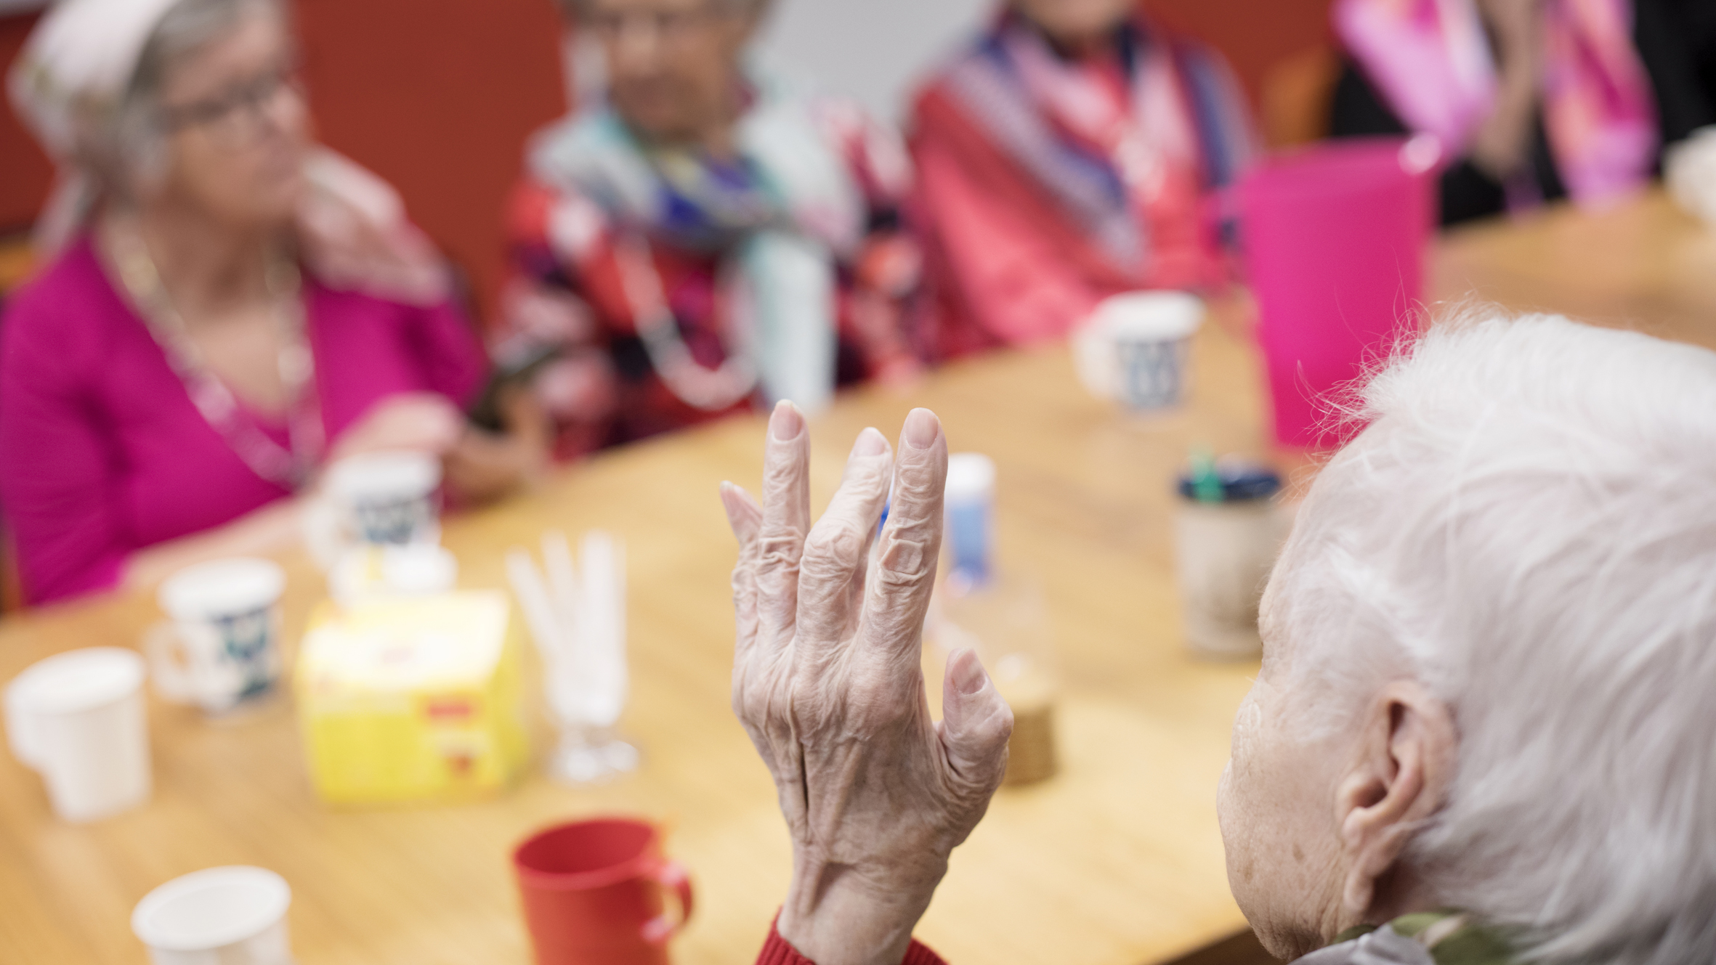
Helsinki
Last decade
Next decade?

Slide 3
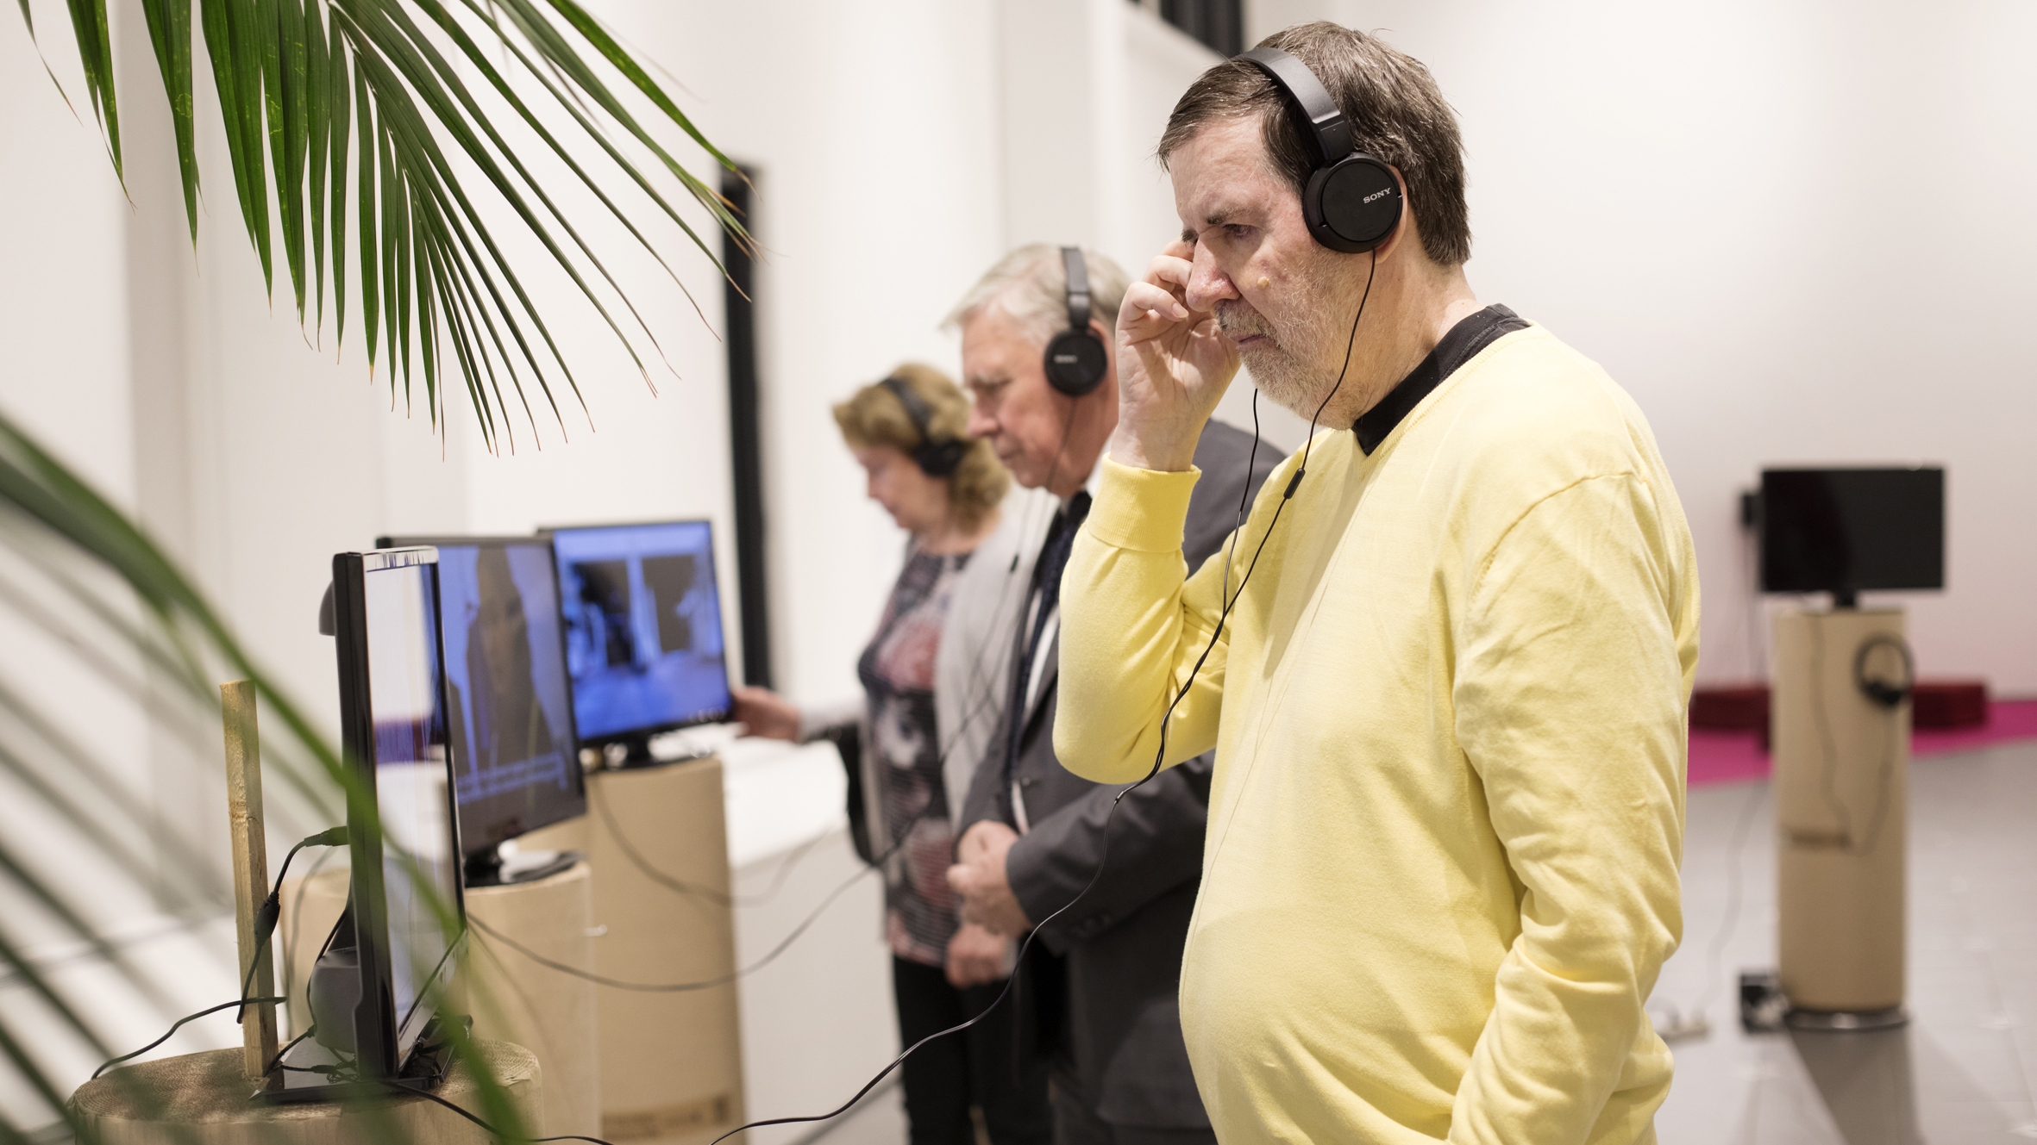
Helsinki

Slide 4
Helsinki
Growing, diversifying capital of Finland, a city of 654 000 residents of which about 110 000 are over the age of 65. In 2030 about 20% over the age of 65. In 2050 the number of residents over the age of 75 has doubled in 2050.
City strategy 2017-2021: The most functional city in the world.
  “Each resident – whether young, old or functionally impaired – has the opportunities to lead a quality and eventful life and to receive the support and services needed for all stages in life. A functional city is an advantage especially for ageing people and those in need of help and support.”
  “Helsinki actively invites ageing people to participate in exercise and cultural activities.”
  In line with acts and laws: The Municipal Cultural Activities Act, Public Libraries Act, Act on Supporting the Functional Capacity of the Older Population and on Social and Health Services for Older Persons
Municipal elections in spring 2021, a new mayor

Slide 5
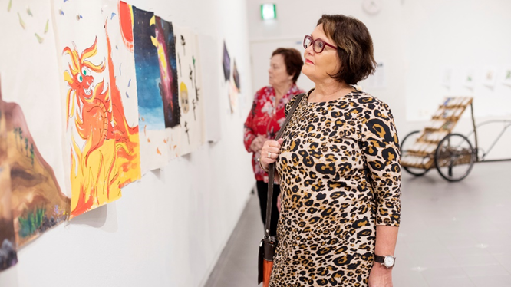
Last decade

Slide 6
Great work!
A decade of incredibly persistent work for making the case, sense making, setting the base, piloting and establishing services.
The main aim: to secure cultural rights for elderly people
Two main approaches:
  Accessible, age friendly cultural services
  Elderly care
In the core of success: cross organizational collaboration, shared human resources, building trust and mutual understanding:
  Arts and culture are seen having an important role in promoting health and wellbeing. Promoting health and wellbeing is seen as an important opportunity for arts and culture.

Slide 7
Learnings
Approach the phenomenon broadly and try to understand the whole system
Understand how the system(s) works and what kind of behavior/results/problems current structures create in order to be able to affect and innovate solutions
Innovation acts are needed on a wide array of change levers all at once
At all levels cross-sectional co-operation is crucial: state, municipalities, city organisation divisions, ecosystem
Create more possibilities for professionals to come and learn together and create new shared knowledge in the ecosystem

Slide 8
During the past decade a special attention has been put to create a joint infrastructure in the field of creative ageing within the City of Helsinki.
This is the base we build on the next decade.

Slide 9
Infrastructure
Health and Welfare Plan for the Senior Citizens
According to law each city/municipality needs to do a special plan to support the health and wellbeing of their senior residents once during each term of office
Culture Services and City Library
Elderly Care
Executive Board of
Culture and Leisure Sector
Executive Board of
Social and Health Care Sector
Heads of Elderly Care, Culture Director, Library Director
Meetings twice a year
Age Friendly Cultural Services Team
Includes a representatives from all the different cultural services (museums, orchestra etc.) and from the City Library
Meetings 4 times a year
Arts- and culture-based elderly care Team
Includes 18 representatives from different postions of elderly care
Meetings 7 times a year
+
Eco-
system!
Cultural Instructors working in elderly care homes
Meetings 4 times a year

Slide 10
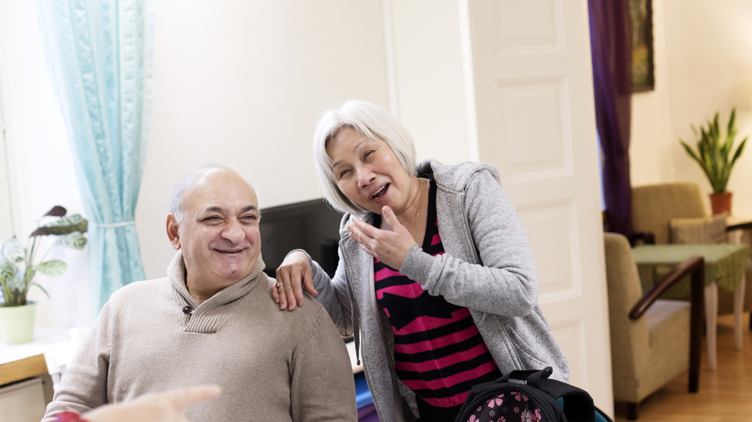
2. Administrational Level
Next decade?

Slide 11
Next decade – vision
Art and culture in Helsinki 2030. The committee’s vision for the city and its citizens, March 2020
Input, feed for new city strategy
  Helsinki holds art and culture at the heart of good living and city development.
    In 2030 everyone in Helsinki has a lifelong connection to art. The cultural rights of older people are realised throughout the city and the accessible opportunities for cultural activities available to them have developed and diversified. New technology-based services and opportunities have been widely adopted. Cultural work with older people is an important part of the City’s services. Services and resources for cultural work with older people will be increased to correspond with the growing number of older people.

Slide 12
2021 – and beyond
Commitment in the city organisation: cross organizational objectives defined and written together for health and wellbeing
  Supporting the ability to live an active and meaningful life
  Physical and mental activity
Shift in perspective: City of Helsinki is part of the ecosystem and an enabler, platform and convener for the ecosystem
New sources of funding and grants (inheritance by the state 850k) for arts and culture organisations for developing:
  Cultural services – near home and online
  Network of volunteers
  Knowhow, skills, data
  Emphasis on projects that highlight participation, accessibility and innovative partnering
Collaboration between cities continues: Lämpiö-project between 5 cities in developing digital accessibility of cultural services for elderly (interactive online platform for finding services, research in digital cultural experience and participation, education and data)
More active collaboration with research and education.
Exploring and piloting tools to strategically develop and manage the whole, share information and understanding end engage ecosystem and funding. Innovation portfolio?
      From national collaboration to more active international collaboration?

Slide 13
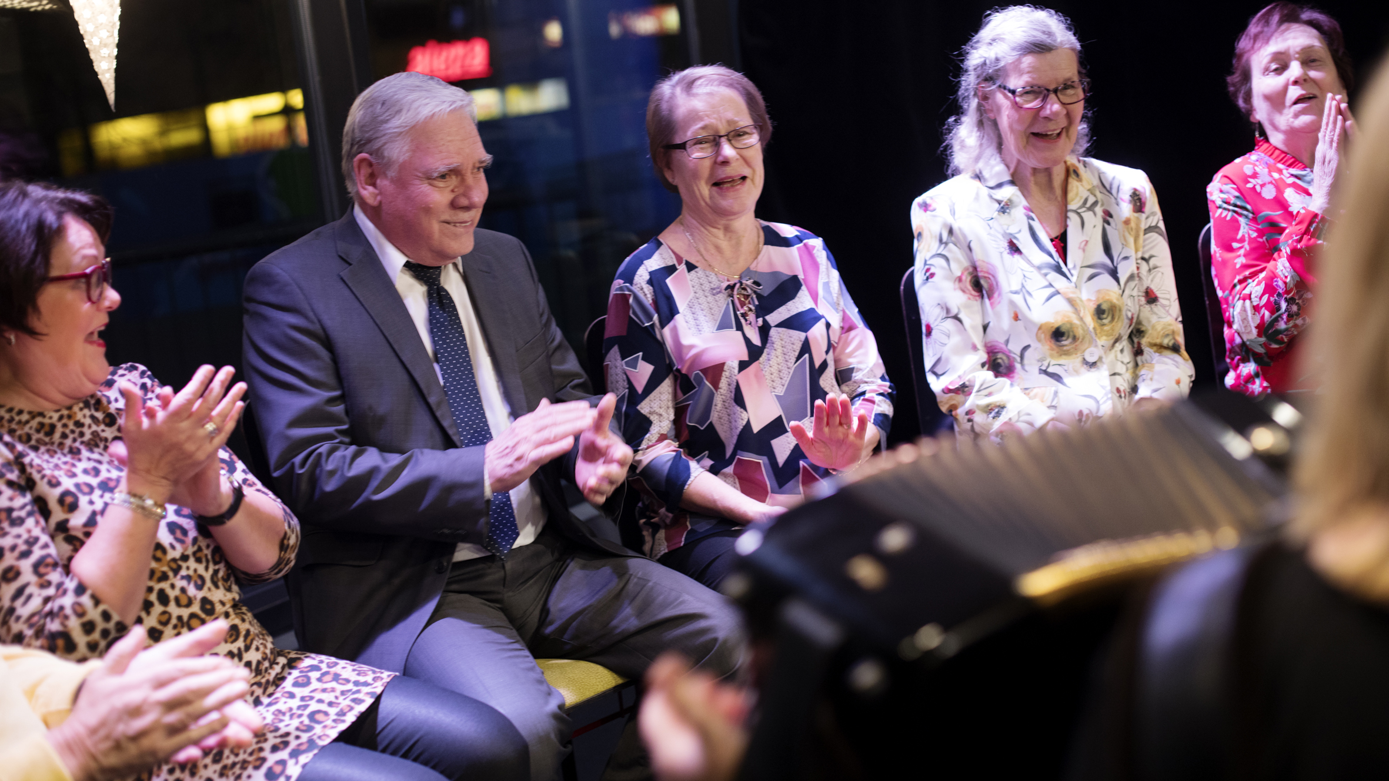
Thank you.

